Slide 1


Introduction to MDP Modeling and Interaction via RDDL and pyRDDLGy
Part 2
Ayal Taitler and Scott Sanner
University of Toronto
Tutorial, ICAPS
July 10th, 2023
Notes:
1

Slide 2
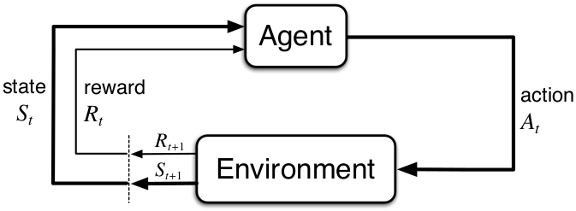
MDP Modeling
Markov Decision Process (MDP):
S – States (discrete/continuous/hybrid)
A – Actions (discrete/continuous/hybrid)
R – Reward function (scalar)
T – Transition function (conditional probability function)

Slide 3
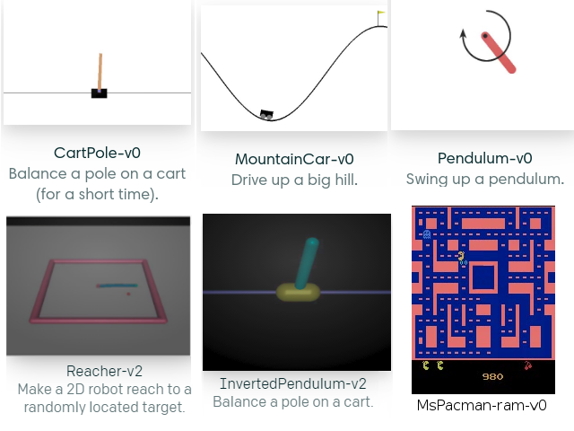
OpenAI Gym
OpenAI gives an interface to implement MDPs
Direct environment implementation
Python coding of the logic
Gaps
Time consuming
Hard coded parameters
Minor change = new implementation
Infinite implementations
No clean way to verify
No access to the model

Slide 4
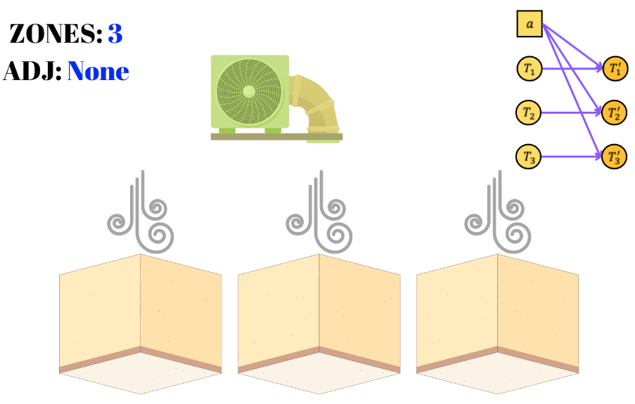
HVAC – scenario 1

Slide 5
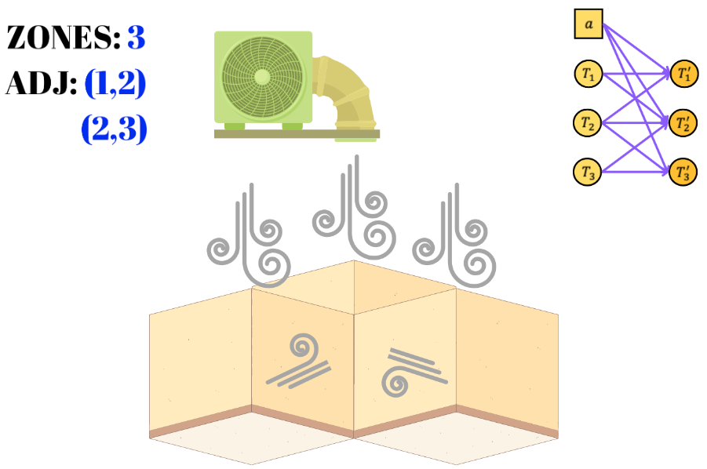
HVAC – scenario 2

Slide 6
Motivation
One mathematical problem
Two env implementations With a lot of code duplication
Identical input/output (actions/states)
Different transition function

Slide 7


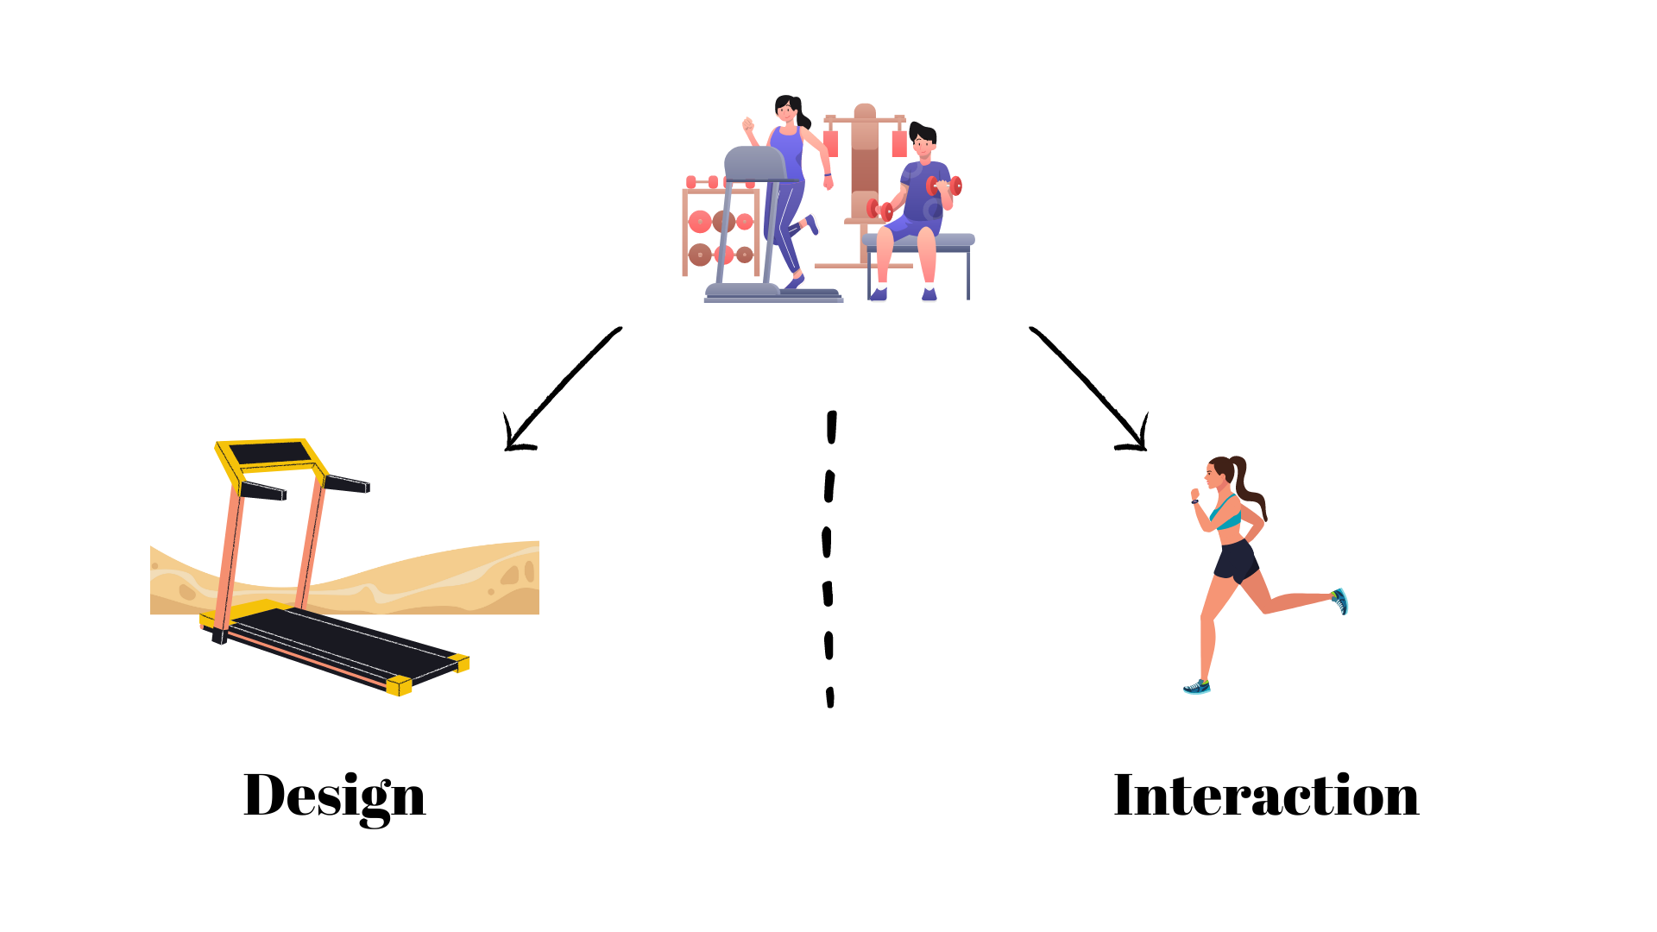
Motivation
OpenAI gives an interface to implement MDPs
Direct environment implementation
Python coding of the logic
Who’s doing the implementation? 🤔

Slide 8
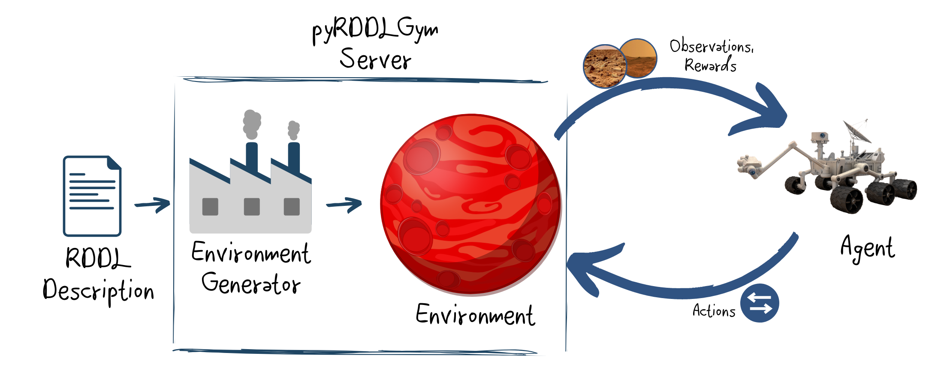
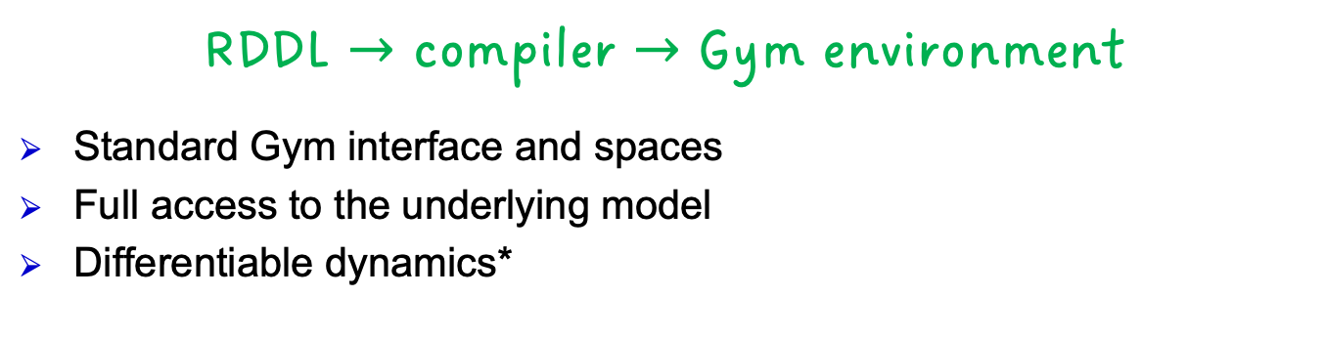
pyRDDLGym
RDDL $→$ compiler $→$ Gym environment
Standard Gym interface and spaces
Full access to the underlying model
Differentiable dynamics*

Slide 9
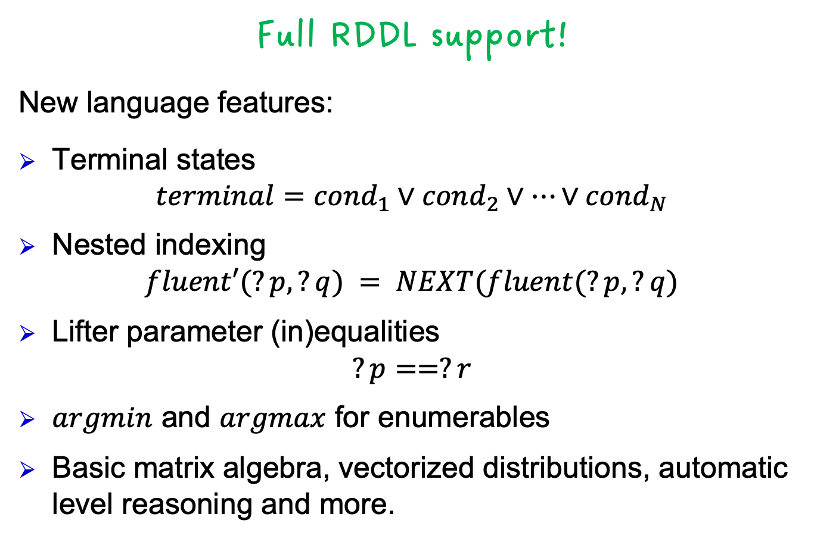
Language Variant
Full RDDL support!
New language features:
Terminal states
$$terminal=cond_{1}∨cond_{2}∨…∨cond_{N}$$
Nested indexing
$$fluent′(?p,?q) = NEXT(fluent(?p, ?q)$$
Lifter parameter (in)equalities
$$?p==?r$$
$argmin$ and $argmax$ for enumerables
Basic matrix algebra, vectorized distributions, automatic level reasoning and more.

Slide 10
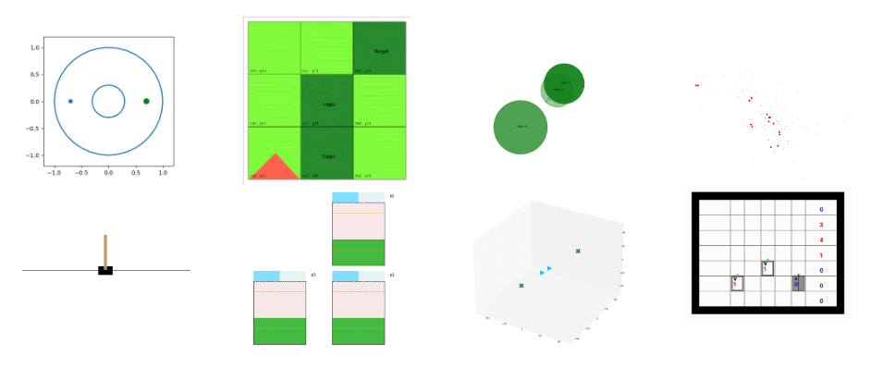
Built-in Environments*
Gym’s Classical control environments
All previous RDDL domains
New exciting environments
*RDDLRepositoy – home to all things RDDL, https://github.com/ataitler/rddlrepository

Slide 11
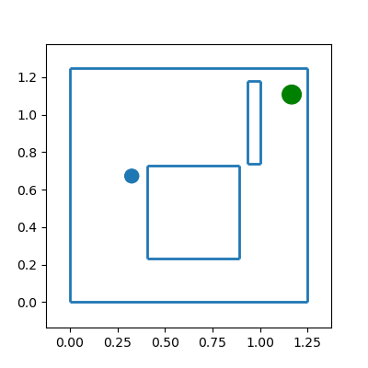
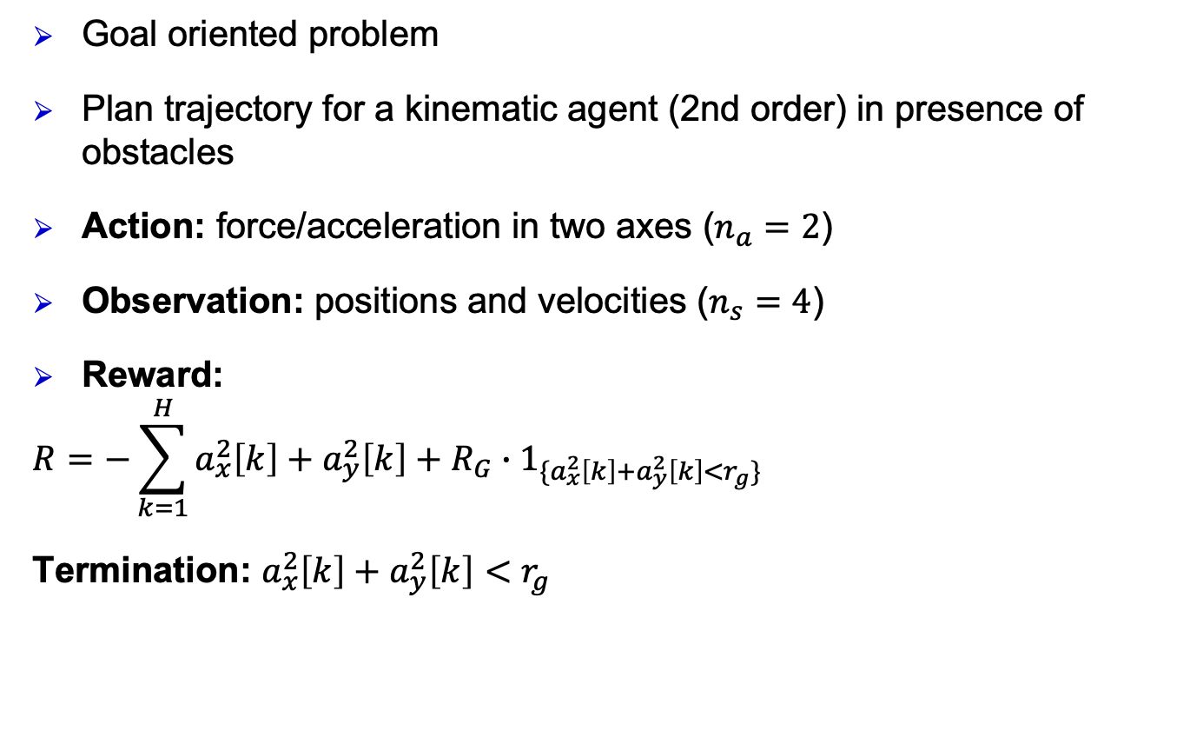
Built-in Environments – RaceCar
Goal oriented problem
Plan trajectory for a kinematic agent (2nd order) in presence of obstacles
Action: force/acceleration in two axes ($n_{a}=2$)
Observation: positions and velocities ($n_{s}=4$)
Reward:
$$R=−\sum_{k=1}^{H}{a_{x}^{2}\left[k\right]+a_{y}^{2}\left[k\right]+R_{G}{∙1}_{\{a_{x}^{2}\left[k\right]+a_{y}^{2}\left[k\right]<r_{g}\}} }$$
Termination: $a_{x}^{2}\left[k\right]+a_{y}^{2}\left[k\right]<r_{g}$

Slide 12
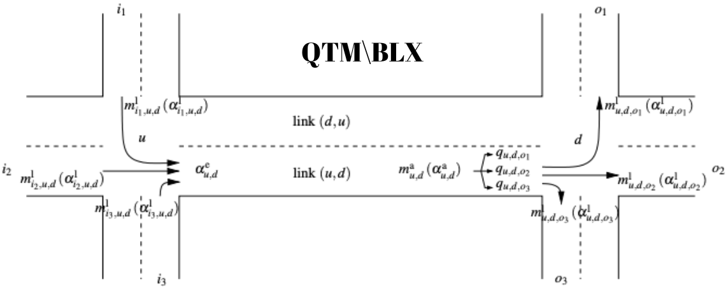
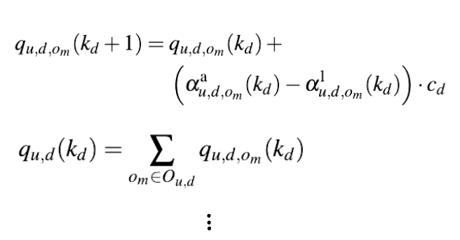
Built-in Environments – Traffic
Traffic network cogestion control
Action: Extend/Change for light phases (each intersection)
Observation: Cars in queues, phase, phase time, etc.
Reward: Total travel time (number of cars in the network)
Constraints: Min/max time in phase

Slide 13
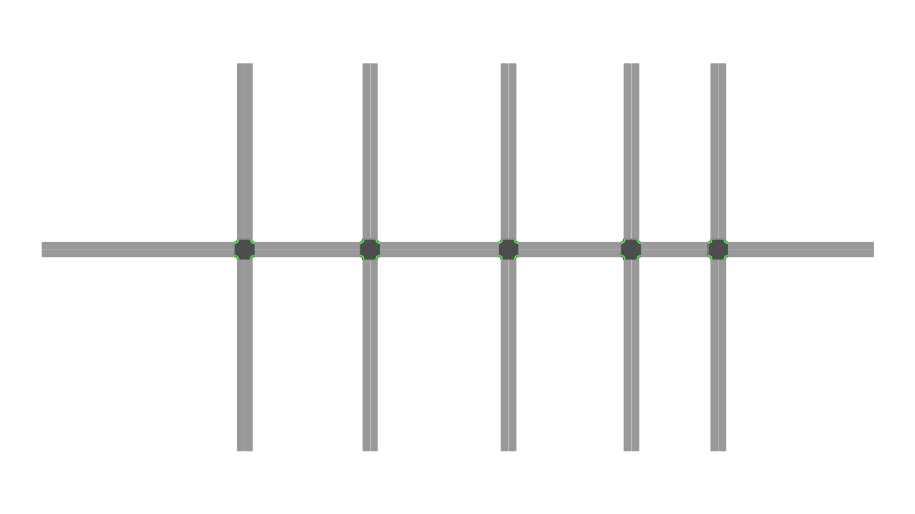
Built-in Environments – Traffic
1x5 Network

Slide 14
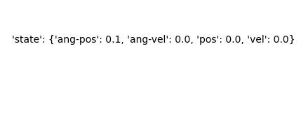
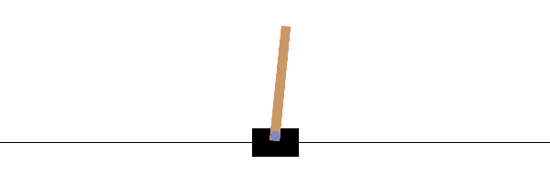
Visualizers
pyRDDLGym comes with a built-in TextVisualizer class
It is simple to create customs visualizers
Inherit base class pyRDDLGym.Visualizer.StateViz
(non-)Fluents are available through the self._model dictionary
One an use his favorite graphical lib, e.g., matplotlib, pygame, etc…

Slide 15
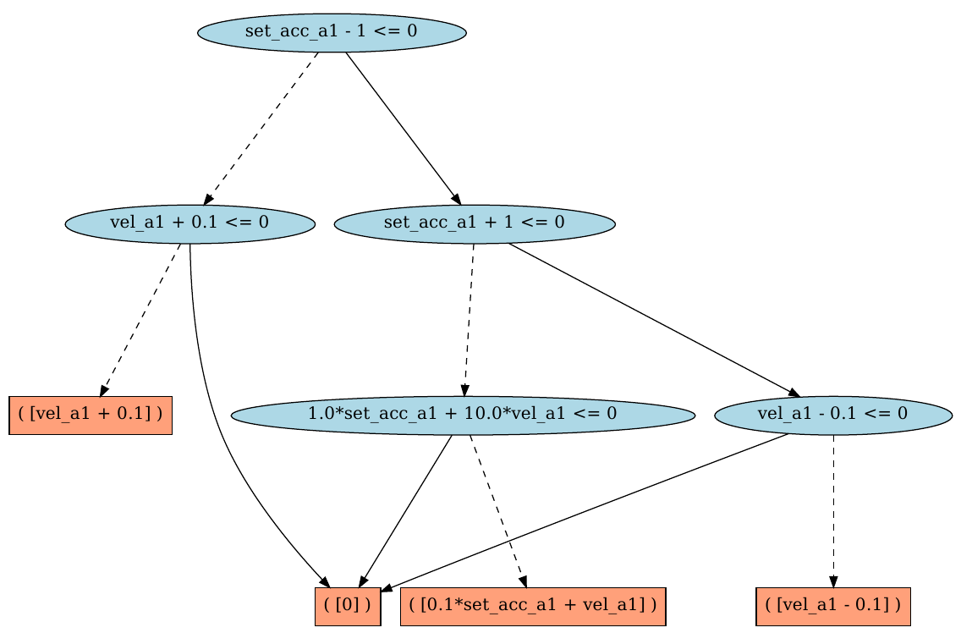
Auxillary Tools (I)
Extended Algebric Decision Diagrams (XADDs)
Symbolic function representation for Piecewise Linear functions
Compact representation of the grounded cpfs
Symbolic Dynamic Programming (SDP)
Representation and framework backend
XADD for the UAV domain

Slide 16
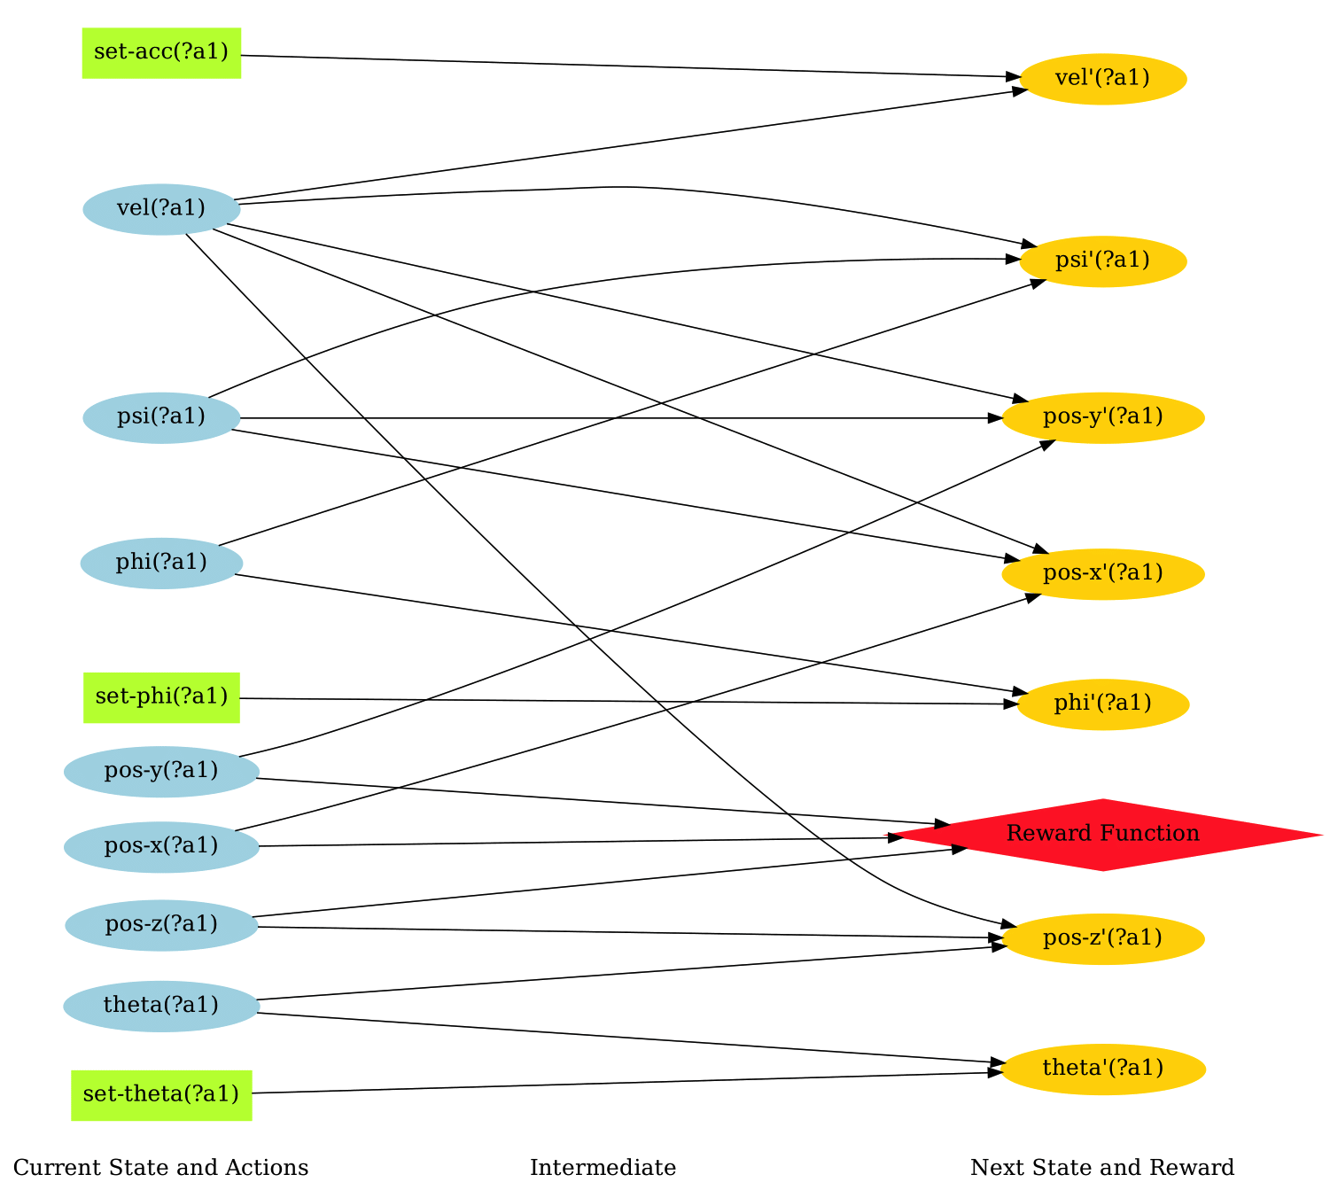
Auxillary Tools (II)
Dynamic Bayes Nets (DBNs) visualization
Visualization of the causal relations
Causality inference
Direct GCN methods e.g., SymNets (symbolic Networks)
DBN visualization

Slide 17
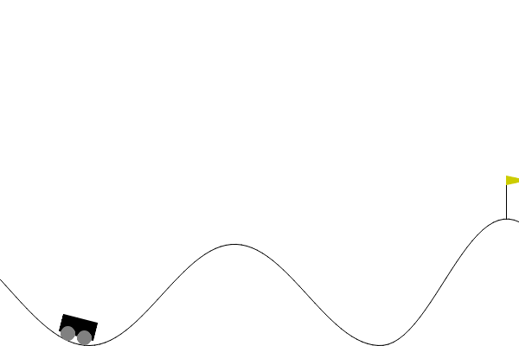
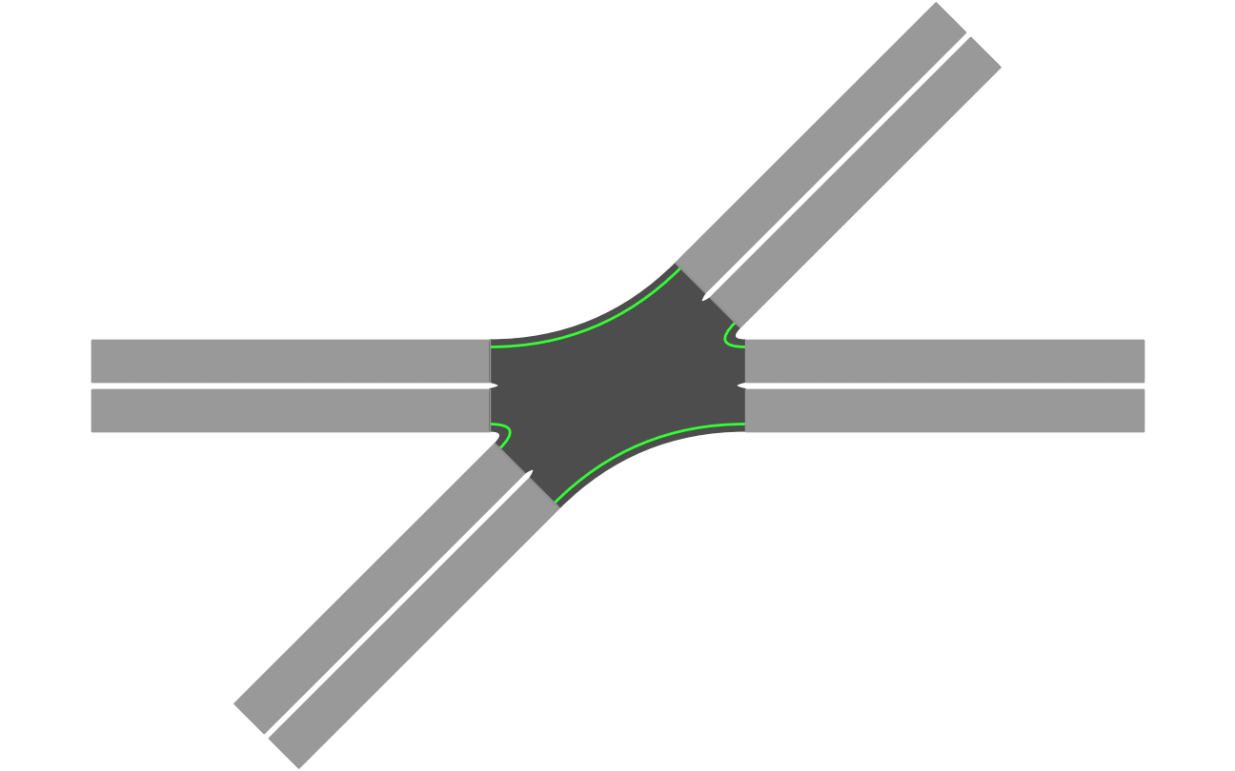
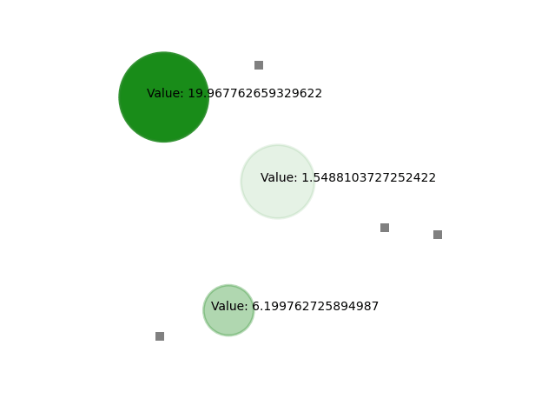
Auxillary Tools (III)
Movie Generator
Built-in functionality for movie generations of episodes
Supports GIF and MP4

Slide 18
JAXPLANNER

Slide 19
Built-in Model-based Planner
Simulate: Given plan $a_{0}$, $a_{1}$, . . . , simulate states $s_{t}$and reward $r_{t}$
Dynamic Bayes’ Net (DBN)

Slide 20

Built-in Model-based Planner
Optimize: Adjust $a_{t}$ based on the return gradient
$$a_{t}^{′}=a_{t}+η∇_{a_{t}}\sum_{τ}{r_{τ}}$$
Wu, Ga, Buser Say, and Scott Sanner. ”Scalable planning with tensorflow for hybrid nonlinear domains.” NeurIPS (2017).

Slide 21
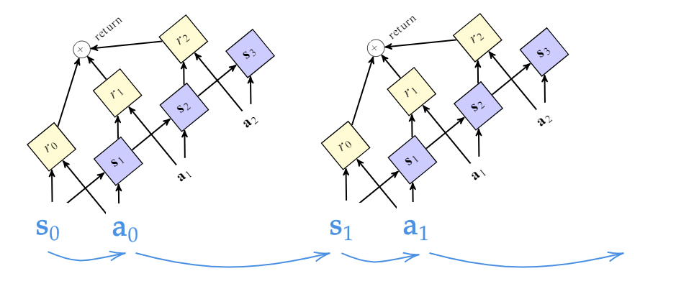
Built-in Model-based Planner
Closed-loop plan: Periodic re-planning (rolling horizon)

Slide 22
Built-in Model-based Planner
Closed-loop plan: Deep reactive policy
Bueno, T. P., de Barros, L. N., Mauá, D. D., and Sanner, S. Deep Reactive Policies for Planning in Stochastic Nonlinear Domains. AAAI (2019).

Slide 23
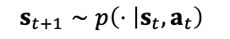
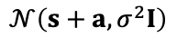
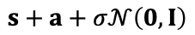
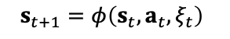
Built-in Model-based Planner
Stochastic domains: Use the reparameterization trick
$$𝒩\left(s+a,σ^{2}I\right)$$
$$s+a+σ𝒩\left(0, I\right)$$
$$s_{t+1}∼p\left(⋅ | s_{t},a_{t}\right)$$
$$s_{t+1}=φ\left(s_{t},a_{t},ξ_{t}\right)$$
Bueno, T. P., de Barros, L. N., Mauá, D. D., and Sanner, S. Deep Reactive Policies for Planning in Stochastic Nonlinear Domains. AAAI (2019).

Slide 24
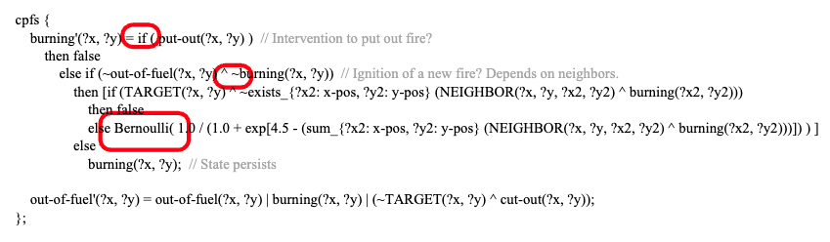
Built-in Model-based Planner
“Not all domains are born continuous”
– Anonymous

Slide 25
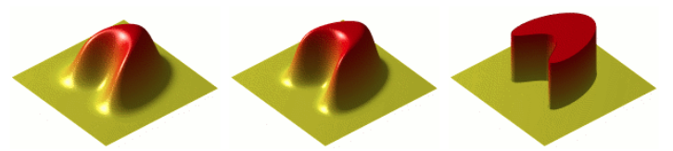
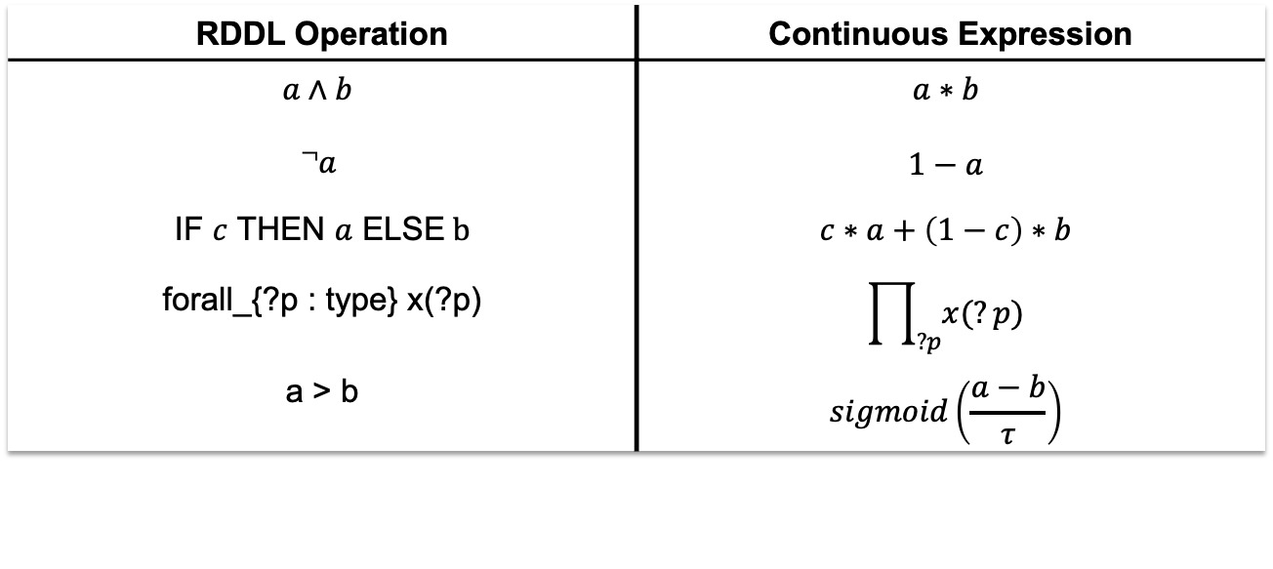
Built-in Model-based Planner
T-norm Fuzzy logic
$$f_{c}:{\left\{0,1\right\}}^{n}→\left[0,1\right]$$
𝑓_𝑐:{0,1}^𝑛→[0,1]
RDDL Operation | Continuous Expression
$$a∧b$$ | $$a∗b$$
$${}_{}^{¬}a$$ | $$1−a$$
IF $c$ THEN $a$ ELSE$b$ | $$c∗a+\left(1−c\right)∗b$$
forall_{?p : type} x(?p) | $$\prod_{?p}{x(?p)}$$
a > b | $$sigmoid\left(\frac{a−b}{τ}\right)$$

Slide 26
Hands-on
Colab notebook
Basic pyRDDLGym usage
Modeling and execution
JaxPlanner

